Slide 1

PROJECT ON
VIRTUAL MEDICAL HOME

Slide 2
PROBLEM ABSTRACT
Existing system:
Presently all the hospital functionalities are done manually.
The sophisticated medical equipments and services are not available in all the areas.
If a person want sophisticated medical service he has to travel long way to multi-speciality hospitals, take appointments and has to wait till chance called.
Drawbacks in Existing system:
Very few or no doctors at remote locations.
Limited hour services and lack of sophisticated medical equipments.
No patients history/lab data management.
Various changes to information like patient details, medical details are difficult to make as paper work is involved.
Time consuming.

Slide 3
PROPOSED SYSTEM
The solution to the problems of existing system is our proposed system “Virtual Medical Home” in which we automate all the manual tasks.
Advantages:
Provides online medical services to all people whether they are in metro or remotely located areas.
Users can connect through their home internet.
Management of patient’s lab reports and history is very easy.
Communication between all the users are provided by chats.
Telecenters data is also maintained.
Ensures data accuracy and security.

Slide 4
FUNCTIONAL AND USER REQUIREMENTS
Functional Requirements:
1. Users profile management and registration.
2. Patients to make online appointment, look their previous health records, doctor’s prescriptions, lab reports and medical expenses.
3. Doctor’s to give appointments, e-prescriptions, and view patient’s history.
4. Admin to see/adjust appointments, perform day open and close activities and calculate his commission.
5. In case of any medical error (wrong medication or lab report) patient can register a complaint. Patient’s grievance and feedback goes to Admin he can forward it to any doctor to answer.
6. Facilitate appropriate communication between all stakeholders - Discussion forum/chat/mail/polls.
7. Site should have details online help manual for patients. Local language support is essential.
8. Admin to take backup of all kind of data, view log and generate system reports.
User Requirements:
1. Professional look and feel.
2. Use of AJAX at least with all registration forms.
3. Browser testing and support for IE, NN, Mozilla, and Fire fox.
4. Reports exportable in .XLS, or any other desirable format.

Slide 5
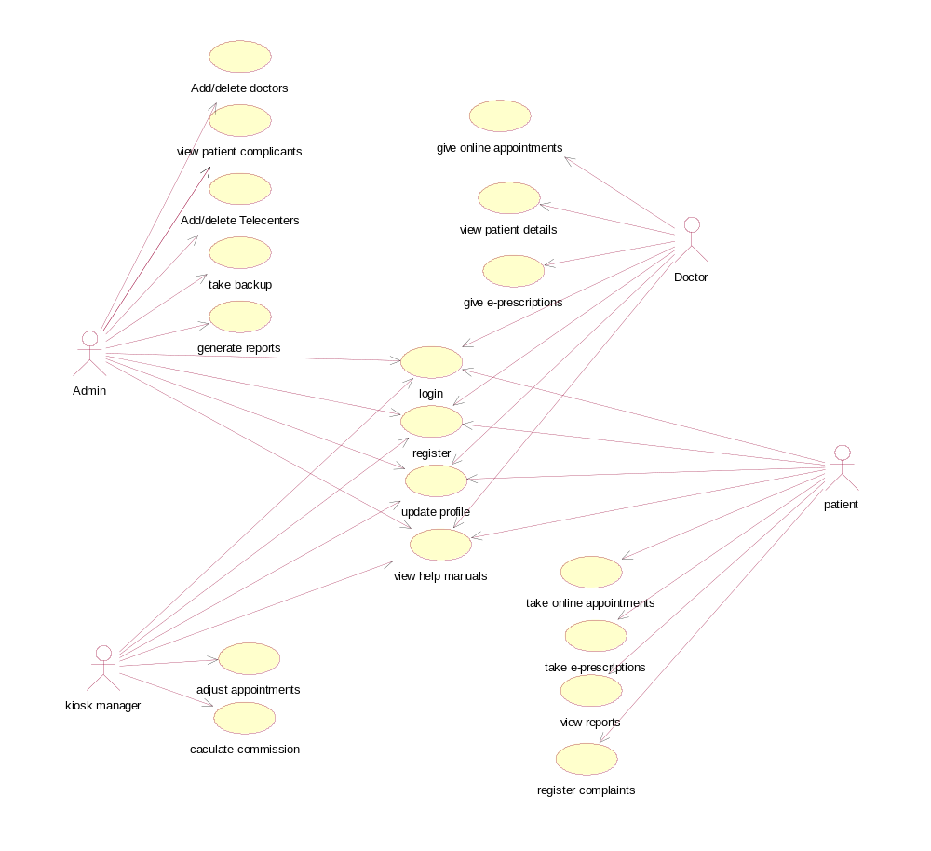
USE CASE DIAGRAM

Slide 6
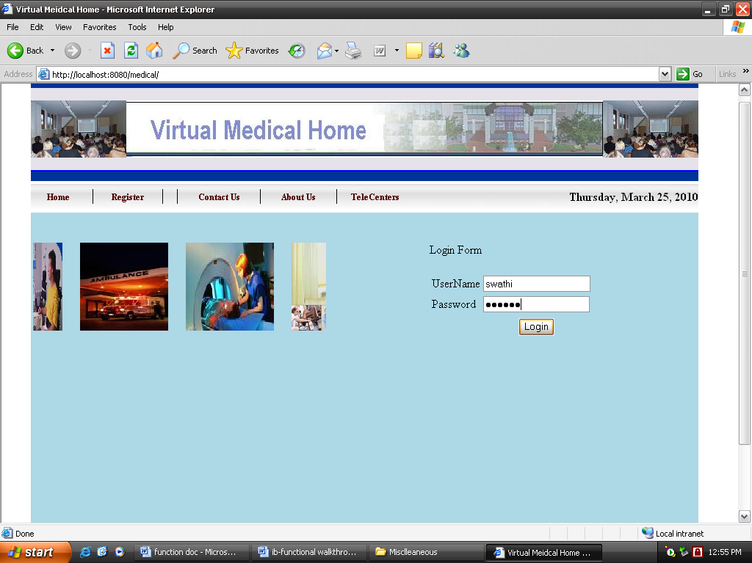
PROJECT SCREEN SHOTS
Invoke the Login page of Virtual Medical Home using
url: http://localhost:8080/medical/Login.jsp

Slide 7
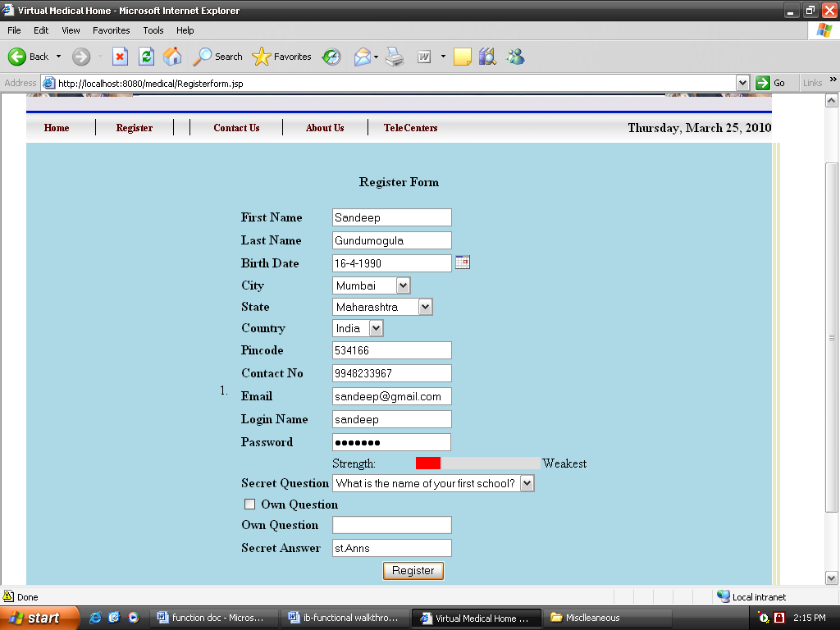
New user should get registered.

Slide 8
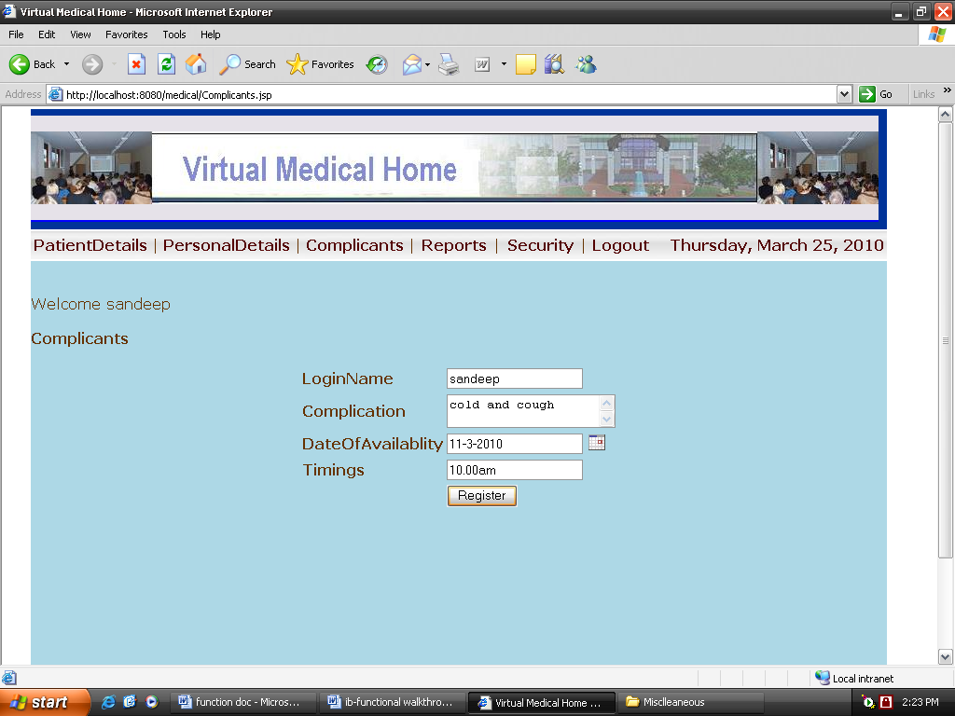
Patients can take online appointments from the doctors.

Slide 9
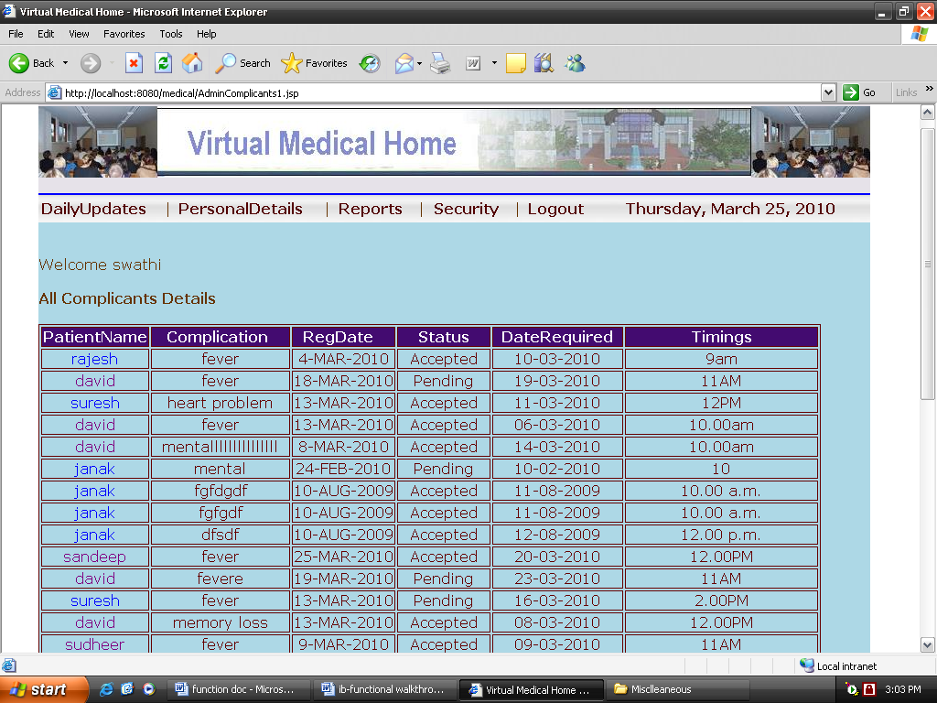
Patients can view their history and lab reports.

Slide 10
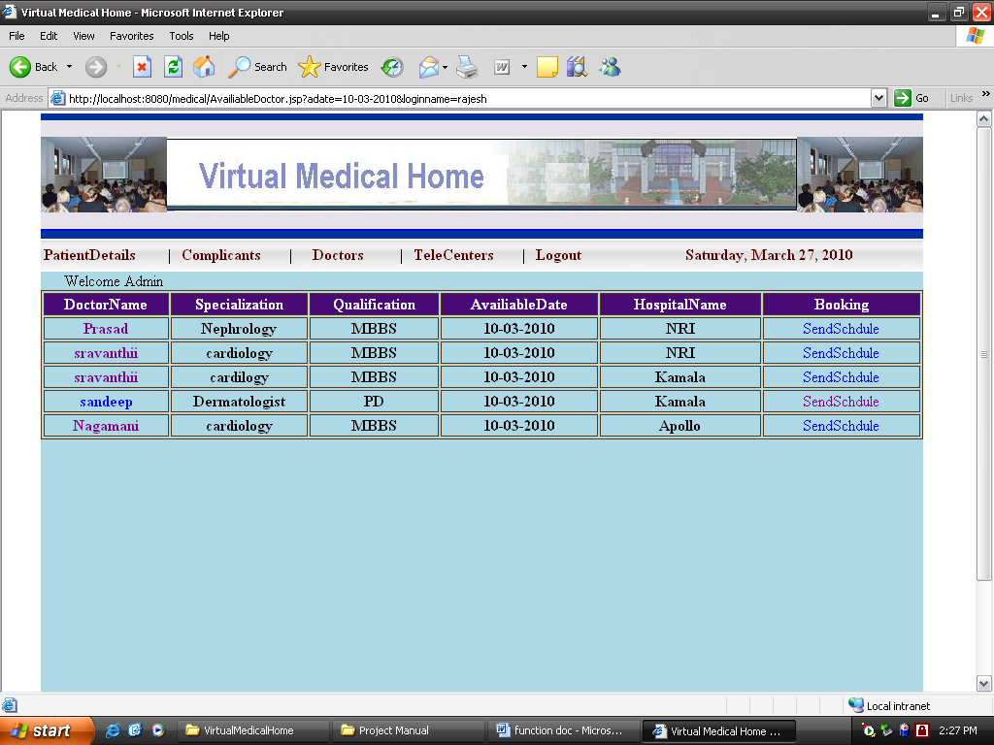
Admin should see/adjust appointments of the registered patients.

Slide 11
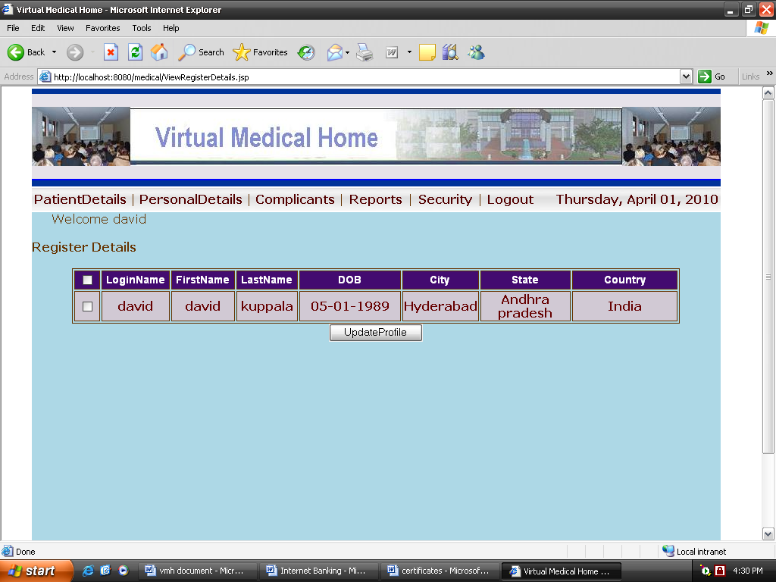
Users can update their profiles.

Slide 12
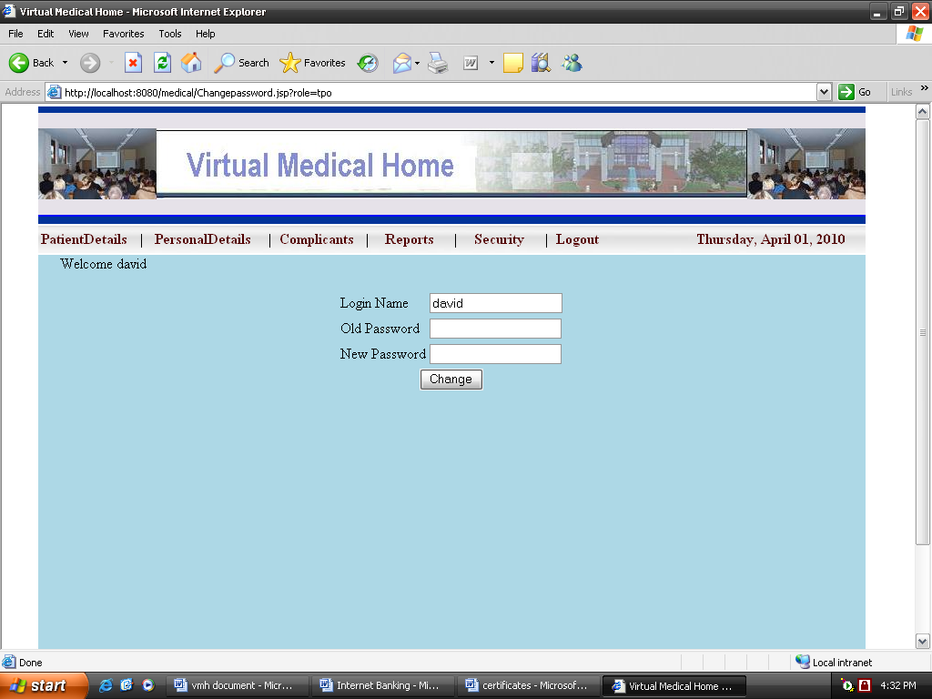
Users can change their password.

Slide 13
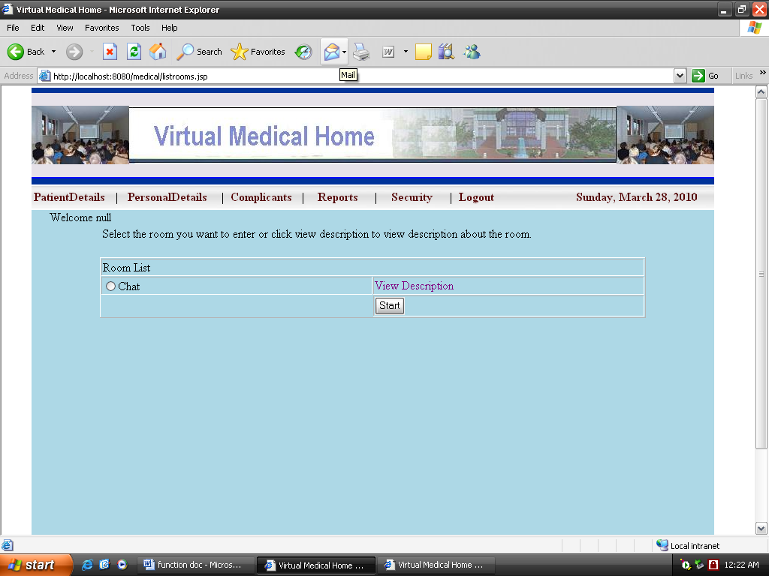
Facilitate appropriate communication between all the users through chats.

Slide 14
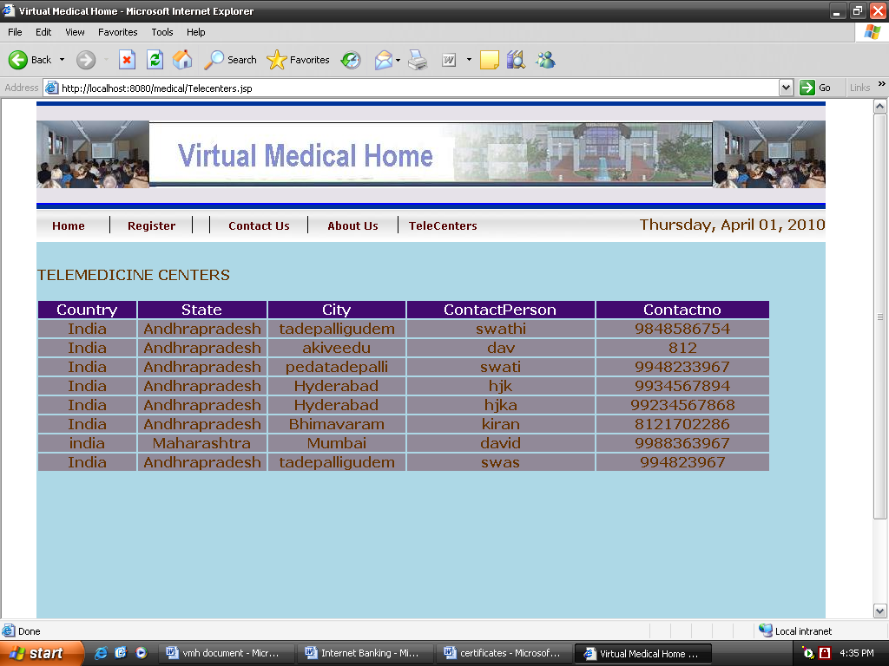
Users can view the details of the Telecenters.

Slide 15
TESTING
Verify that the user should be able to login through the system ‘Virtual Medical Home’.
Verify that the user should be able to register through the system.
Verify that the user should be able to take and give online appointments.
Verify that the user should be able to view his previous health records and lab reports.
Verify that the user should be able to update his profile and also can change his password.
Verify that the users are able to communicate with each other by chat.
Verify the reports generated by Admin.

Slide 16
STRENGHTS:
Good look and feel
Easy navigation from one page to another page.
User can easily communicate with each other by chats.
Reduces the paper work and the users' data can be stored and retrieved at faster speed and accuracy.
WEAKNESS:
Absence of J2ME for high security implementation.
Online appointments and prescriptions are not suggested in some serious health situations as it needs direct interaction with the doctor.

